Slide 1
Angle Modulation Course Teacher Dr. Monir Morshed Professor, Dept. of ICT Email:monirmorshed.ict@mbstu.ac.bd

Slide 2
Angle Modulation: Introduction
Angle Modulation is the process in which the frequency or the phase of the carrier signal varies according to the message signal.
Angle modulation are two types:
Frequency Modulation (FM)
Phase Modulation (PM)
It is used for:
Commercial radio broadcasting
Television sound transmission
Two way mobile radio
Cellular radio
Microwave and satellite communication system

Slide 3
Angle Modulation: Introduction
Features of angle modulation:
It can provide a better discrimination (robustness) against noise and interference than AM
This improvement is achieved at the expense of increased transmission bandwidth
In case of angle modulation, channel bandwidth may be exchanged for improved noise performance
Such trade- off is not possible with AM

Slide 4
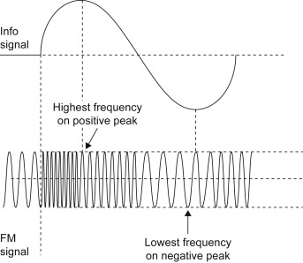
Frequency Modulation
In FM the carrier amplitude remains constant& the carrier frequency varies with the amplitude of modulating signal.
The amount of change in carrier frequency produced by the modulating signal is known as frequency deviation.

Slide 5
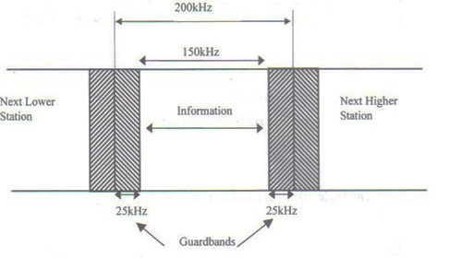
Frequency Modulation
Important features of FM:
The frequency varies.
The rate of change of carrier frequency changes is the same as the frequency of the information signal
The amount of carrier frequency changes is proportional to the amplitude of the information signal.
The amplitude is constant.
FM frequency allocation by FCC

Slide 6
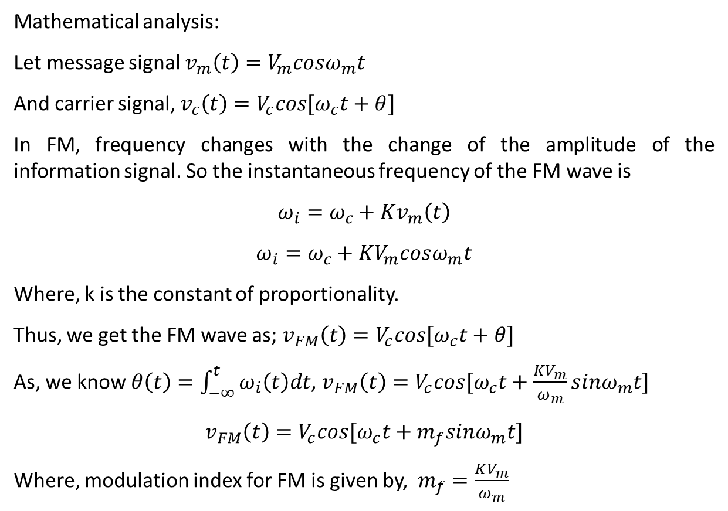
Analysis of FM
Mathematical analysis:
Let message signal $v_{m}\left(t\right)=V_{m}cosω_{m}t$
And carrier signal, $v_{c}\left(t\right)=V_{c}cos{[ω}_{c}t+θ]$
In FM, frequency changes with the change of the amplitude of the information signal. So the instantaneous frequency of the FM wave is
$$ω_{i}=ω_{c}+Kv_{m}\left(t\right)$$
$$ω_{i}=ω_{c}+KV_{m}cosω_{m}t$$
Where, k is the constant of proportionality.
Thus, we get the FM wave as; $v_{FM}\left(t\right)=V_{c}cos{[ω}_{c}t+θ]$
As, we know $θ\left(t\right)=\int_{−∞}^{t}{ω_{i}\left(t\right)dt}$, $v_{FM}\left(t\right)=V_{c}cos{[ω}_{c}t+\frac{KV_{m}}{ω_{m}}sinω_{m}t]$
$$v_{FM}\left(t\right)=V_{c}cos{[ω}_{c}t+m_{f}sinω_{m}t]$$
Where, modulation index for FM is given by, $m_{f}=\frac{KV_{m}}{ω_{m}}$

Slide 7
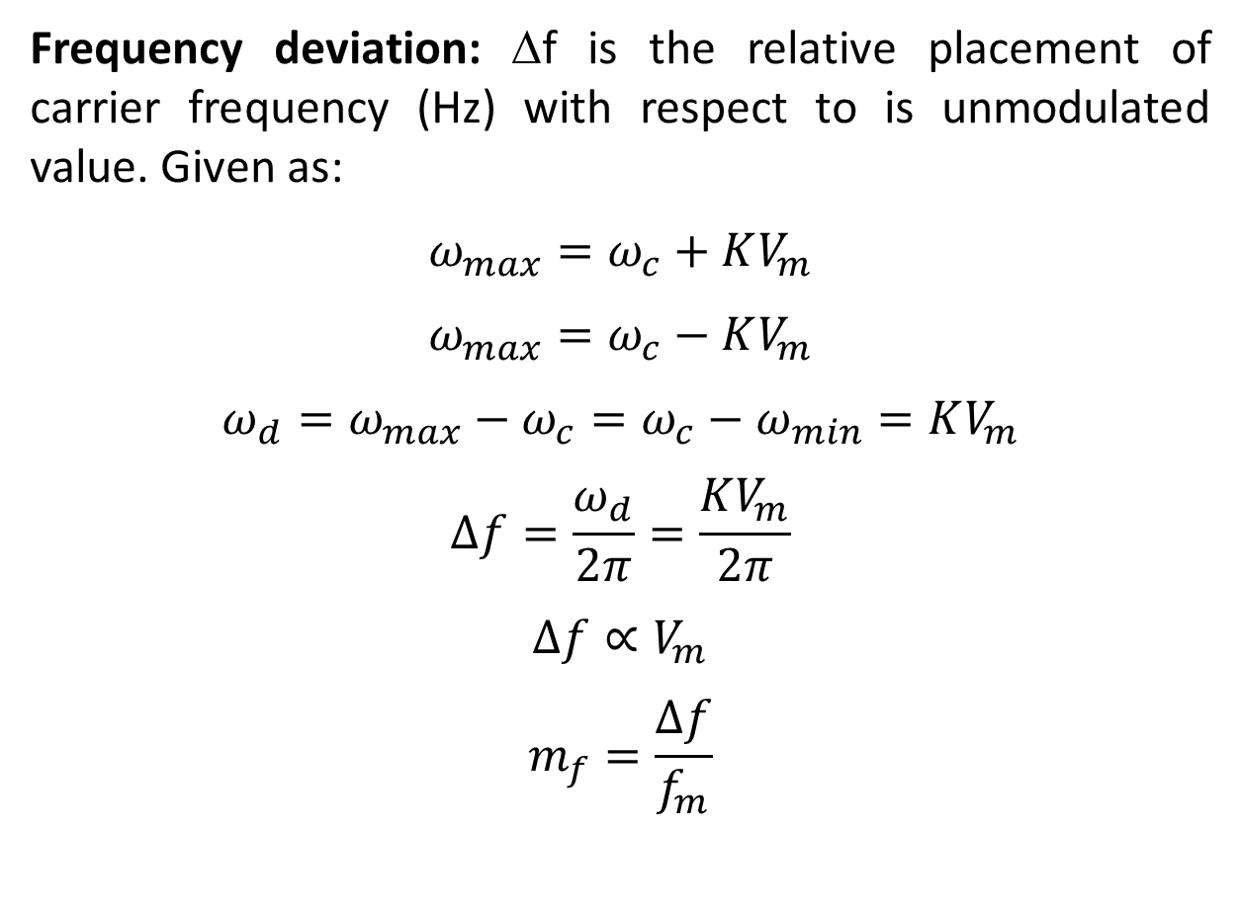
Analysis of FM
Frequency deviation: Δf is the relative placement of carrier frequency (Hz) with respect to is unmodulated value. Given as:
$$ω_{max}=ω_{c}+KV_{m}$$
$$ω_{max}=ω_{c}−KV_{m}$$
$$ω_{d}={ω_{max}−ω}_{c}=ω_{c}−ω_{min}=KV_{m}$$
$$∆f=\frac{ω_{d}}{2π}=\frac{KV_{m}}{2π}$$
$$∆f∝V_{m}$$
$$m_{f}=\frac{∆f}{f_{m}}$$

Slide 8
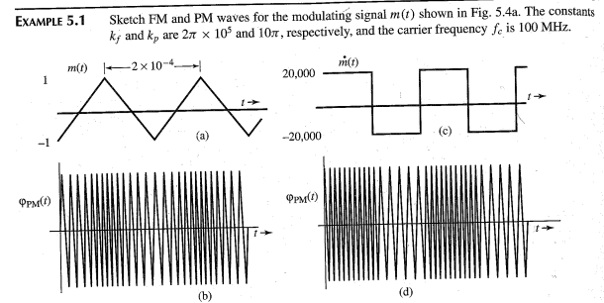
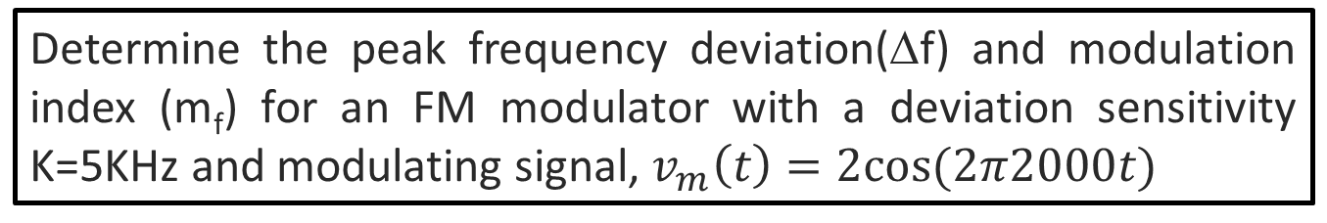
Example of FM
Determine the peak frequency deviation(Δf) and modulation index (m_{f}) for an FM modulator with a deviation sensitivity K=5KHz and modulating signal, $v_{m}\left(t\right)=2cos⁡(2π2000t)$

Slide 9
Example of FM
Determine the peak frequency deviation(Δf) and modulation index (m_{f}) for an FM modulator with a deviation sensitivity K=5KHz and modulating signal, $v_{m}\left(t\right)=2cos⁡(2π2000t)$

Slide 10
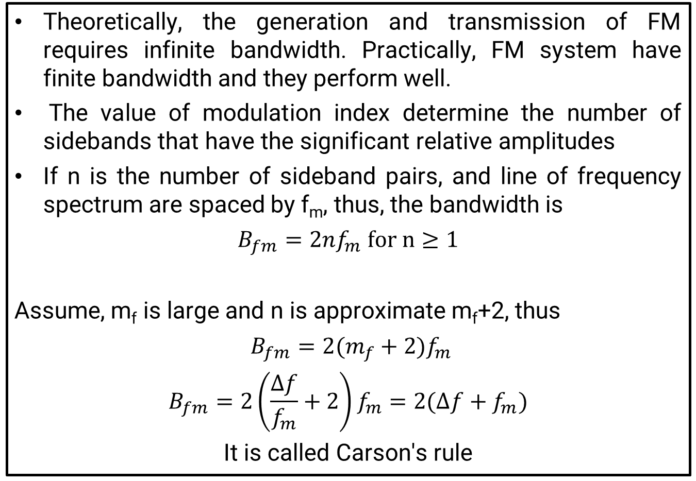
FM Bandwidth
Theoretically, the generation and transmission of FM requires infinite bandwidth. Practically, FM system have finite bandwidth and they perform well.
The value of modulation index determine the number of sidebands that have the significant relative amplitudes
If n is the number of sideband pairs, and line of frequency spectrum are spaced by f_{m}, thus, the bandwidth is
$$B_{fm}=2nf_{m} for n≥1$$
Assume, m_{f} is large and n is approximate m_{f}+2, thus
$B_{fm}=2(m_{f}+2)f_{m}$
$$B_{fm}=2\left(\frac{∆f}{f_{m}}+2\right)f_{m}=2(∆f+f_{m})$$
It is called Carson's rule

